Slide 1

NATIONAL UNIVERSITY OF MODERN LANGUAGES
Faculty of Engineering and Computing
Department of Software Engineering

Slide 2

SOFTWARE DESIGN AND ARCHITECTURE
LECTURE NO. 11
Introduction to Software Engineering Design
Course Instructor: | Mr. Ahsan Arif
 | Lecturer Department of Software Engineering NUML Islamabad
Date: May 13, 2024
Software Engineering Design: Theory and Practice

Slide 3
LECTURE CONTENTS
  Patterns and Styles in Software Architecture
    Architectural and Design Patterns
      Layered Pattern
      Client Server
      Master Slave
      Pipe Filter
      Peer-to-Peer
      Model View Controller (MVC)
Date: May 13, 2024
Software Engineering Design: Theory and Practice

Slide 4
ARCHITECTURAL AND DESIGN PATTERNS
Introduction:
Architectural patterns are high-level structures that define the overall organization of a software system.
  They describe the components of a system, the relationships between those components, and the way that those components interact.
Design patterns, on the other hand, are solutions to common software design problems.
  They provide a template that can be used to solve a particular problem in a flexible and reusable way.
Both architectural and design patterns leverage experience and best practices to help us build software systems that are effective, efficient, and maintainable.
Date: May 13, 2024
Software Engineering Design: Theory and Practice
Notes:
Class diagrams model the static behavior of objects, i.e.
Attributes of objects
Operation of objects
Relationships between objects.

Slide 5
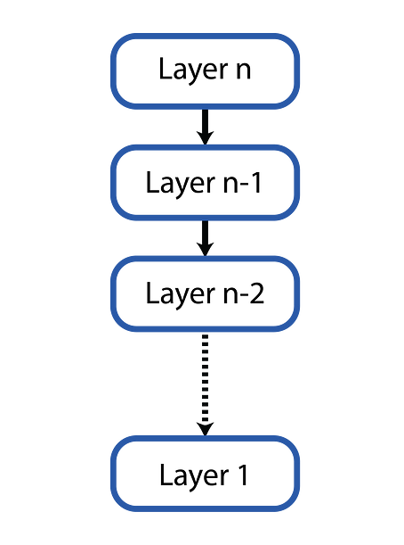
Layered Pattern
Layered Architecture Pattern
Building modular and maintainable applications
The layered architecture pattern is a fundamental software design pattern that structures an application into horizontal layers.
  Each layer has specific responsibilities and interacts with the layers above and below it in a well-defined way.
  This modular approach promotes;
    loose coupling,
    improves maintainability, and
    simplifies the development process.
Date: May 13, 2024
Software Engineering Design: Theory and Practice
Notes:
Class diagrams model the static behavior of objects, i.e.
Attributes of objects
Operation of objects
Relationships between objects.

Slide 6
Layered Pattern
Benefits of Layered Architecture
Improved Maintainability: Changes to one layer are less likely to impact other layers due to loose coupling.
Increased Reusability: Components within a layer can be reused across different applications.
Enhanced Testability: Each layer can be tested independently, simplifying the testing process.
Clearer Separation of Concerns: Each layer focuses on a specific aspect of the application, making the code easier to understand and manage.
Date: May 13, 2024
Software Engineering Design: Theory and Practice
Notes:
Class diagrams model the static behavior of objects, i.e.
Attributes of objects
Operation of objects
Relationships between objects.

Slide 7
Layered Pattern
Disadvantages of Layered Architecture
Overhead:
  The use of multiple layers can result in additional overhead, which can affect the performance of the system.
Complexity:
  The layered architecture pattern can become complex, especially when dealing with large systems, which can make it challenging to manage and maintain.
Date: May 13, 2024
Software Engineering Design: Theory and Practice
Notes:
Class diagrams model the static behavior of objects, i.e.
Attributes of objects
Operation of objects
Relationships between objects.

Slide 8
Layered Pattern
Common Layers in a Layered Architecture
Presentation Layer: Responsible for how the application is presented to the user. This includes the user interface (UI), reports, and any other way users interact with the system.
Business Logic Layer: Encompasses the core functionalities of the application, implementing business rules and processing data.
Data Access Layer: Manages the interaction with the data storage system, providing methods to retrieve, create, update, and delete data.
Data Storage Layer: Persists the application’s data, typically using a database management system (DBMS) that stores and manages the data used by the application.
Date: May 13, 2024
Software Engineering Design: Theory and Practice
Notes:
Class diagrams model the static behavior of objects, i.e.
Attributes of objects
Operation of objects
Relationships between objects.

Slide 9
Layered Pattern
Considerations for Layered Architecture
Choosing the Right Layers:
The number and granularity of layers will depend on the application’s complexity and requirements.
Defining Clear Interfaces: Well-defined interfaces between layers are crucial for loose coupling and promote easier maintainability and testability.
Date: May 13, 2024
Software Engineering Design: Theory and Practice
Notes:
Class diagrams model the static behavior of objects, i.e.
Attributes of objects
Operation of objects
Relationships between objects.

Slide 10
Layered Pattern
Applications of Layered Software Architecture:
Web applications: Web applications typically use a layered architecture pattern to separate the presentation layer, application layer, and data access layer.
Enterprise applications: Enterprise applications that deal with a large amount of data and transactions can benefit from the layered architecture pattern.
Mobile applications: Mobile applications can also use a layered architecture pattern to separate the UI, business logic, and data access layers.
Date: May 13, 2024
Software Engineering Design: Theory and Practice
Notes:
Class diagrams model the static behavior of objects, i.e.
Attributes of objects
Operation of objects
Relationships between objects.

Slide 11
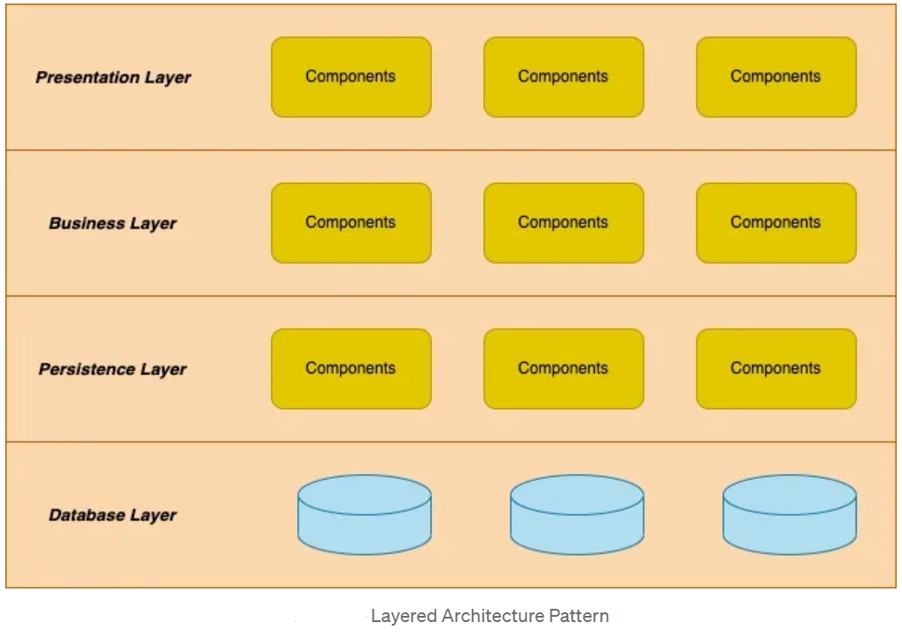
Layered Pattern
Date: May 13, 2024
Software Engineering Design: Theory and Practice
Notes:
Class diagrams model the static behavior of objects, i.e.
Attributes of objects
Operation of objects
Relationships between objects.

Slide 12
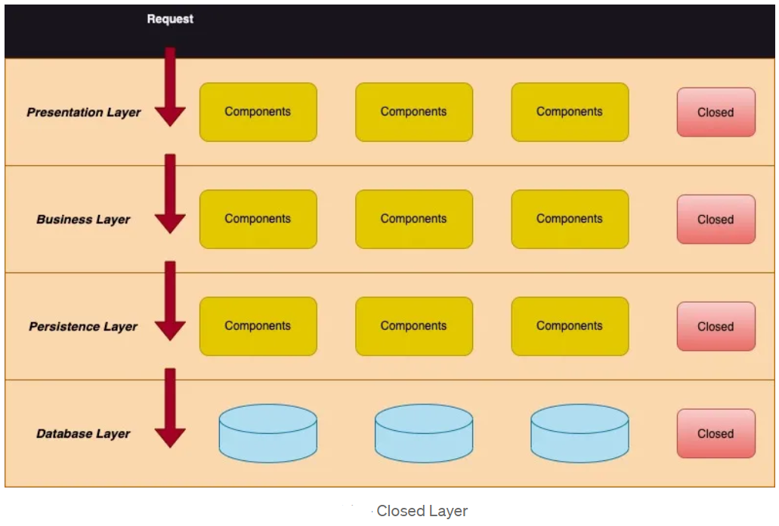
Layered Pattern
Date: May 13, 2024
Software Engineering Design: Theory and Practice
Notes:
Class diagrams model the static behavior of objects, i.e.
Attributes of objects
Operation of objects
Relationships between objects.

Slide 13
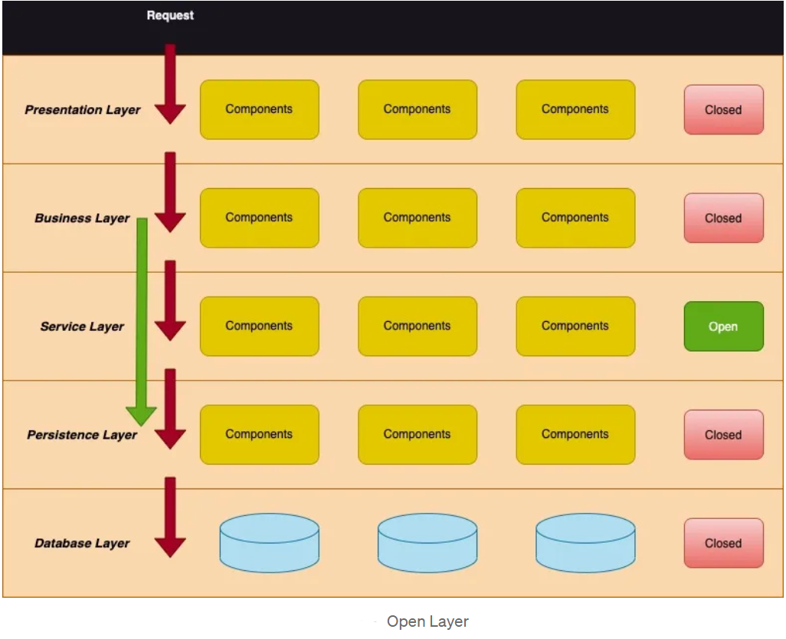
Layered Pattern
Date: May 13, 2024
Software Engineering Design: Theory and Practice
Notes:
Class diagrams model the static behavior of objects, i.e.
Attributes of objects
Operation of objects
Relationships between objects.

Slide 14
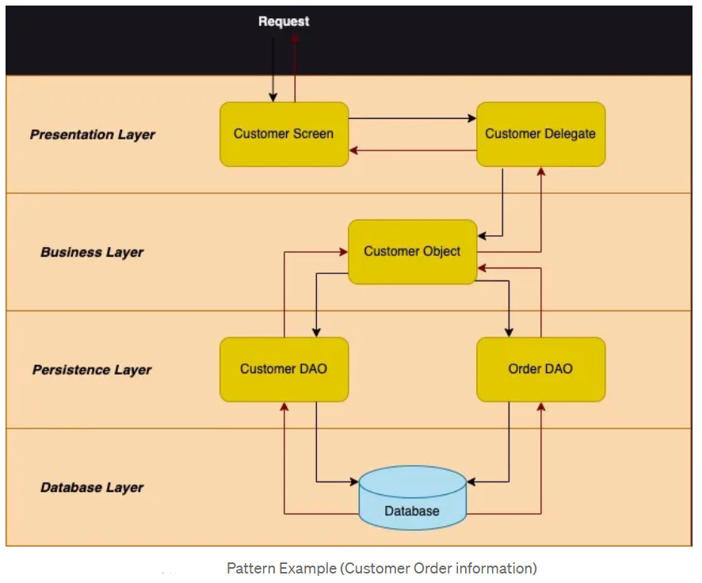
Layered Pattern
Date: May 13, 2024
Software Engineering Design: Theory and Practice
Notes:
Class diagrams model the static behavior of objects, i.e.
Attributes of objects
Operation of objects
Relationships between objects.

Slide 15

Client Server
The client-server software architecture pattern is a model that divides a software system into two primary components: the client and the server.
The client is the user-facing side of the system that handles the presentation and interaction with the user.
The server is responsible for handling the business logic, data management, and other processing tasks.
The client and the server communicate with each other through a network protocol.
This architecture is designed to distribute tasks between the client and the server, where the client requests services or resources from the server, and the server responds to those requests.
Date: May 13, 2024
Software Engineering Design: Theory and Practice
Notes:
Class diagrams model the static behavior of objects, i.e.
Attributes of objects
Operation of objects
Relationships between objects.

Slide 16
Client Server
Advantages of Client-Server Software Architecture
This pattern offers numerous benefits, including:
Scalability: The client-server architecture is designed to handle a large number of clients, making it an excellent choice for applications with high traffic volumes.
Security: This architecture enables data to be stored securely on the server and allows for access control to be implemented, providing an additional layer of security.
Centralized data management: The server handles all the data storage and management, which ensures that data is consistent across all clients.
Reusability: The client-server architecture pattern enables developers to reuse code across multiple clients, which can save development time and costs.
Date: May 13, 2024
Software Engineering Design: Theory and Practice
Notes:
Class diagrams model the static behavior of objects, i.e.
Attributes of objects
Operation of objects
Relationships between objects.

Slide 17
Client Server
Disadvantages of Client-Server Software Architecture
The client-server software architecture pattern also has some disadvantages, including:
Single point of failure: If the server goes down, all the clients connected to it will be affected.
Increased latency: Client-server architecture requires network communication, which can lead to increased latency and slower response times.
More complex: Developing client-server architecture is more complex than developing standalone applications.
Date: May 13, 2024
Software Engineering Design: Theory and Practice
Notes:
Class diagrams model the static behavior of objects, i.e.
Attributes of objects
Operation of objects
Relationships between objects.

Slide 18
Client Server
Applications of Client-Server Software Architecture
The client-server software architecture pattern is widely used in various applications, including:
Web applications: Web applications are a perfect example of client-server architecture, where the web browser acts as the client, and the web server handles all the backend logic and data management.
Email applications: Email applications like Gmail and Outlook use client-server architecture to manage emails and other data.
Gaming applications: Multiplayer games like World of Warcraft and Fortnite use client-server architecture to manage game logic and data.
Remote Desktop Applications: Remote desktop applications like TeamViewer use client-server architecture to enable remote access to a computer.
Date: May 13, 2024
Software Engineering Design: Theory and Practice
Notes:
Class diagrams model the static behavior of objects, i.e.
Attributes of objects
Operation of objects
Relationships between objects.

Slide 19
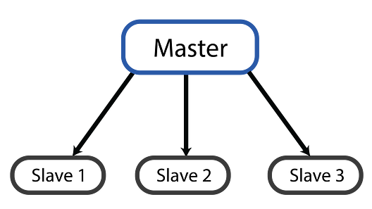
Master Slave Pattern
The Master-Slave software architecture pattern is a model that divides a distributed system into two primary components: the master node and the slave nodes
The master node is responsible for managing the system and coordinating the tasks executed by the slave nodes.
The slave nodes execute tasks assigned by the master node and report the results back to it.
The communication between the master node and the slave nodes is typically carried out through a network protocol.
Date: May 13, 2024
Software Engineering Design: Theory and Practice
Notes:
Class diagrams model the static behavior of objects, i.e.
Attributes of objects
Operation of objects
Relationships between objects.

Slide 20
Master Slave Pattern
Advantages of Master-Slave Software Architecture
This pattern offers numerous benefits, including:
Scalability: The architecture allows for the addition of more slave nodes as the workload increases, improving the system’s scalability.
Load Balancing: The master node assigns tasks to the slave nodes based on their workload, ensuring that the workload is evenly distributed across all slave nodes.
Improved Performance: The architecture enables the system to execute tasks in parallel, improving performance and reducing response time.
Fault Tolerance: The system can continue to function even if one or more slave nodes fail, as other nodes can take over their tasks.
Date: May 13, 2024
Software Engineering Design: Theory and Practice
Notes:
Class diagrams model the static behavior of objects, i.e.
Attributes of objects
Operation of objects
Relationships between objects.

Slide 21
Master Slave Pattern
Disadvantages of Master-Slave Software Architecture
Inherently, this pattern also has some disadvantages, including:
Single point of failure: The system is reliant on the master node, and if it fails, the entire system can become non-functional.
Increased network traffic: The communication between the master node and the slave nodes can lead to increased network traffic and higher latency.
Complexity: Developing a Master-Slave architecture requires more effort than other architectures, making it more complex.
Date: May 13, 2024
Software Engineering Design: Theory and Practice
Notes:
Class diagrams model the static behavior of objects, i.e.
Attributes of objects
Operation of objects
Relationships between objects.

Slide 22
Master Slave Pattern
Applications of Master-Slave Software Architecture
Database Management Systems:
In a database management system, the master node manages the data and coordinates queries, while the slave nodes execute the queries and return the results.
Web Caching Systems:
In a web caching system, the master node manages the cache and coordinates requests from clients, while the slave nodes serve cached content to clients.
Content Distribution Networks (CDNs):
CDNs use a Master-Slave architecture to distribute content to users worldwide, where the master node coordinates the content distribution, and the slave nodes serve the content to users.
Parallel Processing Systems:
In a parallel processing system, the master node divides the workload among the slave nodes and coordinates the results returned by each node.
Date: May 13, 2024
Software Engineering Design: Theory and Practice
Notes:
Class diagrams model the static behavior of objects, i.e.
Attributes of objects
Operation of objects
Relationships between objects.

Slide 23
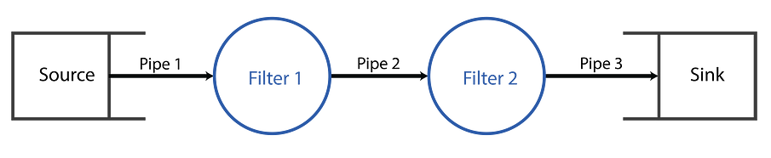
Pipe Filter
The Pipe and Filter software architecture pattern divides a system or application into a series of filters that process data in a specific way. Each filter receives input data, processes it, and then sends it to the next filter through a pipeline.
The pipeline consists of a series of connected filters, each performing a specific task on the data. The data flows from the source through each filter until it reaches the destination.
Date: May 13, 2024
Software Engineering Design: Theory and Practice
Notes:
Class diagrams model the static behavior of objects, i.e.
Attributes of objects
Operation of objects
Relationships between objects.

Slide 24
Pipe Filter
Advantages of Pipe and Filter Software Architecture
The Pipe and Filter software architecture pattern offers several benefits, including:
Modularity: The architecture is modular, with each filter performing a specific task. This makes it easier to add or remove filters as needed.
Reusability: The filters can be reused in other parts of the application or system, reducing development time and cost.
Scalability: The architecture is scalable, with the ability to add more filters to the pipeline to handle increased processing needs.
Flexibility: The architecture is flexible, with the ability to combine filters in different ways to create different processing pipelines.
Date: May 13, 2024
Software Engineering Design: Theory and Practice
Notes:
Class diagrams model the static behavior of objects, i.e.
Attributes of objects
Operation of objects
Relationships between objects.

Slide 25
Pipe Filter
Disadvantages of Pipe and Filter Software Architecture
The Pipe and Filter software architecture pattern also has some disadvantages, including:
Complexity: The architecture can become complex when there are many filters, making it difficult to maintain and debug.
Data Ordering: Maintaining the correct order of the data is crucial to the architecture’s success. Ensuring the correct order can be challenging and time-consuming.
Data Overhead: The architecture can incur additional overhead due to the additional data copying and movement between filters.
Date: May 13, 2024
Software Engineering Design: Theory and Practice
Notes:
Class diagrams model the static behavior of objects, i.e.
Attributes of objects
Operation of objects
Relationships between objects.

Slide 26
Pipe Filter
Example: Simple Image Editing Pipeline (Pipe-Filter Pattern)
Data: An image file uploaded by a user.
Filters:
  Format Validation: Checks if the uploaded file format is supported (e.g., JPG, PNG).
  Resize Filter (Optional): Resizes the image to a specific dimension if needed.
  Filter Application Filter: Applies a chosen filter (e.g., grayscale, sepia) to the image.
  Output Format Filter: Converts the edited image to a desired output format (e.g., maintain original format or change to another).
  Save Filter: Saves the edited image to a designated location.
Output: A processed and edited image file.
Date: May 13, 2024
Software Engineering Design: Theory and Practice
Notes:
Class diagrams model the static behavior of objects, i.e.
Attributes of objects
Operation of objects
Relationships between objects.

Slide 27
Pipe Filter
Benefits:
Modular Image Editing: Allows for adding new filters for different editing effects in the future.
Flexibility: Enables customizing the processing steps (resizing, filtering, format) based on user choices.
Easy Maintenance: Easier to maintain and debug by isolating functionalities within each filter.
Date: May 13, 2024
Software Engineering Design: Theory and Practice
Notes:
Class diagrams model the static behavior of objects, i.e.
Attributes of objects
Operation of objects
Relationships between objects.

Slide 28
Pipe Filter
Applications of Pipe and Filter Software Architecture
Image Processing: In image processing, a pipeline of filters can be used to perform various image processing tasks, such as noise reduction, color correction, and edge detection.
Data Processing: In data processing applications, the architecture can be used to extract, transform, and load data into a data warehouse.
Signal Processing: In signal processing, a pipeline of filters can be used to filter, amplify, and analyze signals.
Web Scraping: In web scraping, a pipeline of filters can be used to extract, clean, and transform data from websites.
Date: May 13, 2024
Software Engineering Design: Theory and Practice
Notes:
Class diagrams model the static behavior of objects, i.e.
Attributes of objects
Operation of objects
Relationships between objects.

Slide 29
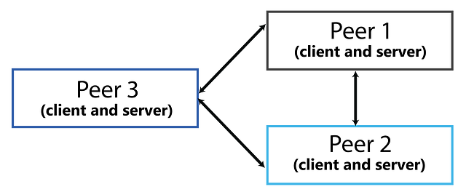
Peer-to-Peer
The Peer-to-Peer software architecture pattern is a type of network architecture in which each device on the network is equal and has the ability to act as both a client and a server.
All nodes on the network can communicate directly with each other, without relying on a central server to manage the communication.
Date: May 13, 2024
Software Engineering Design: Theory and Practice
Notes:
Class diagrams model the static behavior of objects, i.e.
Attributes of objects
Operation of objects
Relationships between objects.

Slide 30
Peer-to-Peer
Advantages of Peer-to-Peer Software Architecture
Decentralization: The architecture provides a decentralized network, where all nodes are equal, and there is no central server to manage the communication. This makes the network more resilient and fault-tolerant, as there is no single point of failure.
Scalability: The architecture is highly scalable, as new nodes can easily join the network and participate in communication.
Resource Sharing: The architecture allows nodes on the network to share resources, such as bandwidth, storage, and processing power, which can lead to more efficient use of resources.
Cost-effective: The architecture is cost-effective, as it does not require a central server to manage the communication.
Date: May 13, 2024
Software Engineering Design: Theory and Practice
Notes:
Class diagrams model the static behavior of objects, i.e.
Attributes of objects
Operation of objects
Relationships between objects.

Slide 31
Peer-to-Peer
Disadvantages of Peer-to-Peer Software Architecture
Security: The decentralized nature of the network can make it difficult to ensure security, as there is no central authority to manage security.
Reliability: The reliability of the network can be affected by the number of nodes on the network and the quality of their connections.
Scalability: Although the architecture is highly scalable, managing a large number of nodes on the network can be challenging.
Date: May 13, 2024
Software Engineering Design: Theory and Practice
Notes:
Class diagrams model the static behavior of objects, i.e.
Attributes of objects
Operation of objects
Relationships between objects.

Slide 32
Model View Controller (MVC)
Applications of Peer-to-Peer Software Architecture
File Sharing: P2P file-sharing applications allow users to share files directly with each other, without relying on a central server. Examples include BitTorrent and Napster.
Voice over IP: P2P Voice over IP (VoIP) applications allow users to make voice calls directly with each other, without relying on a central server. Examples include Skype and Viber.
Gaming: P2P gaming allows players to connect with each other directly, without relying on a central game server. Examples include Minecraft and Call of Duty.
Blockchain: The blockchain technology used in cryptocurrencies, such as Bitcoin and Ethereum, is a distributed ledger system that uses a P2P architecture to manage transactions.
Date: May 13, 2024
Software Engineering Design: Theory and Practice
Notes:
Complexity: So, in simpler applications, using MVC might introduce unnecessary complexity because it involves more separate pieces to manage compared to a more basic approach.
Here's an analogy: Imagine building a birdhouse. You wouldn't need a whole toolbox with hammers, saws, and drills. A screwdriver and some nails might be enough. In the same way, for a small software project, a simpler approach might be sufficient.
Overhead: The additional effort or resources required due to using the MVC pattern. This can involve things like:
Increased code complexity: More code needs to be written to handle communication between the Model, View, and Controller.
Potential for performance impact: Managing the interaction between separate components can add some overhead, especially in resource-constrained environments.
Over-engineering: Creating a solution that's more intricate or elaborate than what's actually required.
MVC pattern: A software design pattern for structuring applications with separate Model (data), View (presentation), and Controller (user interaction) components.
Simple applications: Programs with a limited number of features and functionalities.
So, the MVC pattern is designed for larger applications where separating concerns (data, presentation, user interaction) is beneficial. However, for a simple program, using MVC might introduce unnecessary complexity. It's like using a high-powered tool for a small job.

Slide 33
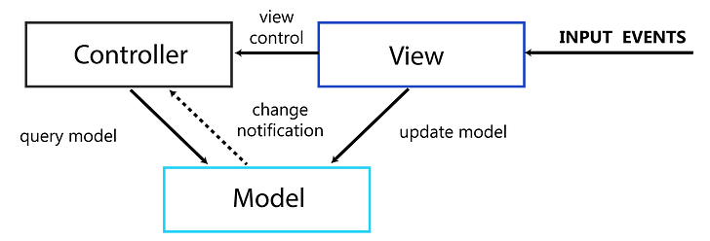
Model View Controller (MVC)
The MVC pattern is a design pattern used to separate the application logic into three interconnected components:
Model: The backend that contains all the data logic
View: The frontend or graphical user interface (GUI)
Controller: The brains of the application that controls how data is displayed
Date: May 13, 2024
Software Engineering Design: Theory and Practice
Notes:
Class diagrams model the static behavior of objects, i.e.
Attributes of objects
Operation of objects
Relationships between objects.

Slide 34
Model View Controller (MVC)
In MVC, the Controller plays a crucial role in applying the separation of concerns principle. It acts as the intermediary between the user interface (View) and the data layer (Model).
User Interaction Handling:
  When a user interacts with the View (e.g., clicking a button, submitting a form), the View doesn’t directly manipulate the Model itself.
  Instead, it sends the user action to the Controller. This allows the View to remain focused on presentation logic and avoids cluttering it with application logic.
Model Update Management:
  The Controller receives the user action and interprets it based on the application’s business logic. It might involve data validation, calculations, or interacting with the Model to update the underlying data.
  This separation ensures that the Model is protected from unintended modifications and maintains data integrity.
Date: May 13, 2024
Software Engineering Design: Theory and Practice
Notes:
Class diagrams model the static behavior of objects, i.e.
Attributes of objects
Operation of objects
Relationships between objects.

Slide 35
Model View Controller (MVC)
Example:
Consider a library management system.
Scenario: A user searches for a book title in the View (search bar).
Action: The View sends the search query to the Controller.
Controller’s Role:
  The Controller receives the query and interacts with the Model (library database) to retrieve relevant book information.
  It might perform additional logic like filtering based on availability.
Updated View: Finally, the Controller instructs the View to display the search results (list of books).
This example demonstrates how the Controller acts as the bridge between user interactions and data updates, applying the knowledge of MVC in a practical scenario.
Date: May 13, 2024
Software Engineering Design: Theory and Practice
Notes:
Class diagrams model the static behavior of objects, i.e.
Attributes of objects
Operation of objects
Relationships between objects.

Slide 36
Model View Controller (MVC)
Advantages of MVC Software Architecture
Separation of Concerns: The separation of the application logic into three components makes it easier to manage and modify the codebase.
Reusability: The components in the MVC pattern are independent of each other, which makes it easier to reuse them in other applications.
Testability: The separation of the components in the MVC pattern makes it easier to write automated tests for each component.
Parallel Development: The MVC pattern allows multiple developers to work on different components of the application simultaneously, which can speed up the development process.
Date: May 13, 2024
Software Engineering Design: Theory and Practice
Notes:
Class diagrams model the static behavior of objects, i.e.
Attributes of objects
Operation of objects
Relationships between objects.

Slide 37
Model View Controller (MVC)
Disadvantages of MVC Software Architecture
Complexity: The MVC pattern can be complex to implement, especially in smaller applications.
Overhead: The use of the MVC pattern can introduce additional overhead, which can negatively impact performance.
Over-engineering: The MVC pattern can be over-engineered for simple applications, which can lead to unnecessary complexity.
Date: May 13, 2024
Software Engineering Design: Theory and Practice
Notes:
Complexity: So, in simpler applications, using MVC might introduce unnecessary complexity because it involves more separate pieces to manage compared to a more basic approach.
Here's an analogy: Imagine building a birdhouse. You wouldn't need a whole toolbox with hammers, saws, and drills. A screwdriver and some nails might be enough. In the same way, for a small software project, a simpler approach might be sufficient.
Overhead: The additional effort or resources required due to using the MVC pattern. This can involve things like:
Increased code complexity: More code needs to be written to handle communication between the Model, View, and Controller.
Potential for performance impact: Managing the interaction between separate components can add some overhead, especially in resource-constrained environments.
Over-engineering: Creating a solution that's more intricate or elaborate than what's actually required.
MVC pattern: A software design pattern for structuring applications with separate Model (data), View (presentation), and Controller (user interaction) components.
Simple applications: Programs with a limited number of features and functionalities.
So, the MVC pattern is designed for larger applications where separating concerns (data, presentation, user interaction) is beneficial. However, for a simple program, using MVC might introduce unnecessary complexity. It's like using a high-powered tool for a small job.

Slide 38
Model View Controller (MVC)
Applications of MVC Software Architecture
Web Development: Many web frameworks, such as Ruby on Rails, Django, and ASP.NET, use the MVC pattern to separate the application logic into separate components.
Mobile Development: The iOS and Android platforms both use the MVC pattern to separate the application logic into separate components.
Desktop Applications: Many desktop applications, such as Adobe Photoshop and Microsoft Office, use the MVC pattern to separate the application logic into separate components.
Games: The Unity game engine uses the MVC pattern to separate the game logic into separate components.
Date: May 13, 2024
Software Engineering Design: Theory and Practice
Notes:
Complexity: So, in simpler applications, using MVC might introduce unnecessary complexity because it involves more separate pieces to manage compared to a more basic approach.
Here's an analogy: Imagine building a birdhouse. You wouldn't need a whole toolbox with hammers, saws, and drills. A screwdriver and some nails might be enough. In the same way, for a small software project, a simpler approach might be sufficient.
Overhead: The additional effort or resources required due to using the MVC pattern. This can involve things like:
Increased code complexity: More code needs to be written to handle communication between the Model, View, and Controller.
Potential for performance impact: Managing the interaction between separate components can add some overhead, especially in resource-constrained environments.
Over-engineering: Creating a solution that's more intricate or elaborate than what's actually required.
MVC pattern: A software design pattern for structuring applications with separate Model (data), View (presentation), and Controller (user interaction) components.
Simple applications: Programs with a limited number of features and functionalities.
So, the MVC pattern is designed for larger applications where separating concerns (data, presentation, user interaction) is beneficial. However, for a simple program, using MVC might introduce unnecessary complexity. It's like using a high-powered tool for a small job.

Slide 39
Summary
In conclusion, a software architecture is a critical aspect of any software system, providing a well-defined structure that ensures scalability, maintainability, and adaptability.
Software architecture patterns are widely used templates for designing software systems that solve common design problems. A well-designed software architecture can greatly benefit businesses, allowing for a more efficient and effective operation.
Date: May 13, 2024
Software Engineering Design: Theory and Practice

Slide 40
Thank You...
Mr. Ahsan Arif
Lecturer (Dept. of Software Engineering)
ahsanarif.se42@gmail.com

